Slide 1
HOUSING POLICY IN THE EUROZONE COUNTRIES
A Multidimensional Contribute to the Analysis of Socio-economic Factors (2010-2014)
António Duarte Santos
Autónoma University of Lisbon, Portugal
CIEO-Research Centre for Spatial and Organizational Dynamics
ajsantos@ual. pt
Guilherme Castela
University of Algarve, Portugal
CIEO-Research Centre for Spatial and Organizational Dynamics
ecastela@ualg. pt
Nelson Silva
CIEO-Research Centre for Spatial and Organizational Dynamics
info@ntavaresdasilva.com

Slide 2
1 Introduction and Objectives
2 Data and Methodological Procedure
3 Results
4 Discussion
5 Conclusion

Slide 3
1 Introduction and Objectives

Slide 4
Introduction
1
Given the growth of housing affordability problems, the decrease in disposable income, the reorganization of behaviour’s households and their adjustment to a new social and economic paradigm, there has been a growing concern about the housing issue. It has therefore become essential to recognize the institutional intervention of economic operators in the market, in particular from the state, owners and households (NEWMANN et al., 2000; HAFFNER et al., 2011; DEWILDE et al., 2014).
2
From early in the decade, and up to 2014, concerns more of social nature were added to these housing policy guidelines, and rehousing programs were created in urban areas, with support for leasing with incentives particularly for young people and stimulus for the recovery of degraded properties. The purchase of homes by households, house renting on the open market – and specifically of young people – pushed the state forward as a stimulating element in the housing market and urban regeneration, theoretically through an equity-based redistribution of income for households (ANDREWS et al., 2011).

Slide 5
Introduction
3
However, the problem of housing cannot be reduced only to a perspective of supply and demand. In fact, the specific characteristics of this problem led to the creation of inefficiencies in the market, in particular due to the inadequacy of market argument as a resolution mechanism for housing in lower-income households.
4
The strengthening of housing programs for the most insolvent populations had the effect of partially solving housing needs, but it was not enough (SANTOS, 2014). In the general European case (DEWILDE, 2016), the housing reality was mainly constructed by the acquisition of one’s own housing, given the comparative low expression of the rental market. Nonetheless, it only provided a housing solution for relatively solvent households. Consequently, in this period, the housing credit supply matured, the interest rates had a significant downward trend, the access to credit of households stabilized and new opportunities arose for the financial institutions (ARESTIS et al., 2013).
5
Therefore, a new relative extension of housing credit and a fresh attitude towards the rental alternative in these years was a rational response of economic agents to favourable changes in financing conditions, and not only in southern Europe countries. On the other side, the development of a more dynamic rental market was another goal of housing policies in this period.

Slide 6
Objectives
1 To generate a methodological approach, with the use of the HJ-BIPLOT method in order to achieve a richer diagnosis, for the 2010-2014 period, of the effects of political, economic and social decisions on the twelve Eurozone Countries, by identifying their similarities and dissimilarities;
2 To identify relationships between wealth, living standards and affordability in the housing problem in twelve Eurozone countries for the period 2010-2014;
3 To recognise behavioural typologies in the twelve Eurozone countries linked to wealth and living standards associated with housing affordability;
4 To distinguish clusters of countries with divergences and/or convergences in the housing sector.

Slide 7
2 Data and Methodological Procedure

Slide 8
Data
The ten variables, classified in five indicators, were those that we considered to be the most relevant for a comparative analysis of results among Eurozone countries
COUNTRIES | COD
Austria | AT
Belgium | BE
Finland | FI
France | FR
Germany | DE
Greece | EL
Ireland | IE
Italy | IT
Luxembourg | LU
Netherlands | NL
Portugal | PT
Spain | ES
INDICATORS | COD | VARIABLES | EUROSTAT database
General Economic Indicator | GDPPC | GDP per capita | nama_10_pc
 | UNP | Unemployment rate - annual average (%) | une_rt_a
Housing Stock Indicator | OML | Owner with mortage or loan (%) | ilc_lvho02
 | TEN | Tennant | ilc_lvho02
Housing Affordability Indicator | SHCI | Share of housing cost in disposable income (%) | ilc_mded01
 | OBD | Housing cost overburden rate (as % of population) | ilc_lvho07a
 | HWEGFI | Annual average index-housing, water, electricity, gas and other fuels | prc_hicp_aind
 | HPI | House prices índex | tipsho20
Population and Social Condition | RPSE | Population at risk of poverty (%) | ilc_peps01
Housing Quality Indicator | OCD | Housing overcrowding rate | ilc_lvho05a
The observations are the first twelve countries of the Eurozone which first used the Euro currency

Slide 9
Methodological Procedure
Classical BIPLOTS, were developed by GABRIEL (1971, 1981) and are used as a data visualization tool essentially due to two properties: the internal product property, which originates an exact or approximated representation of the individuals in space, and the property of equality between the cosine of the angle formed by the vectors which represent two variables and the correlation coefficient between these same variables. As a result of the BIPLOT properties it is possible to identify:
1. The relations between column vectors (individuals);
2. The relations between row vectors (variables);
3. The interrelations between row and column vectors.
1. Type of BIPLOT | HJ-BIPLOT
2. Transformation of data | Column Standardization (z-scores)
3. Estimation Method | Singular Value Decomposition
4. Segmentation Process | Hierarchical Cluster (Ward's Method) with the Euclidean distance using the HJ-BIPLOT scores
The use of the HJ-BIPLOT method (GALINDO, 1986) allows a better simultaneous representation of the effects of political, economic and social decisions in the Eurozone countries, by identifying their similarities and dissimilarities on Housing Policy.

Slide 10
3 Results

Slide 11
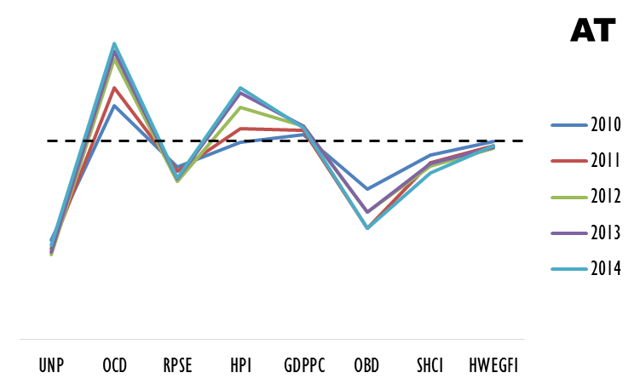
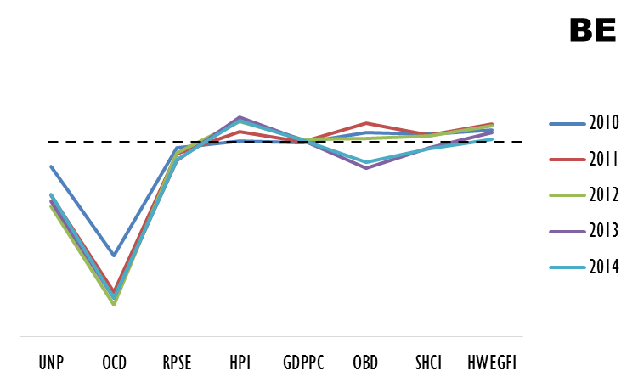
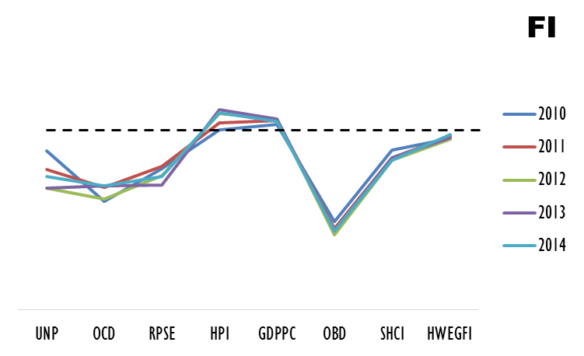
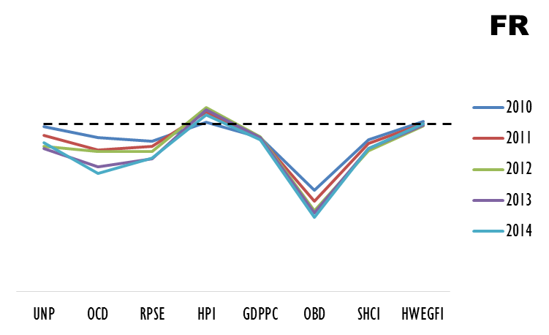
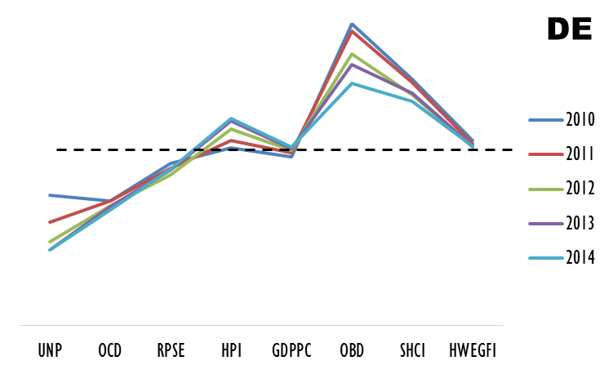
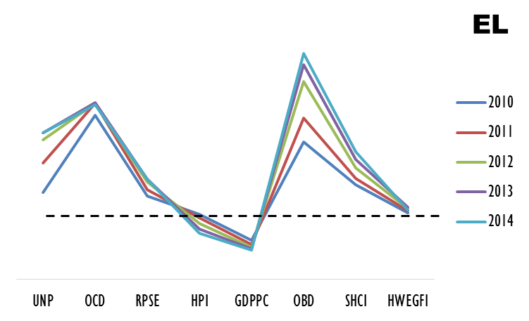
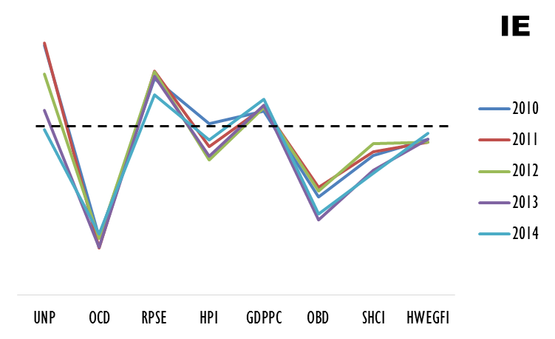
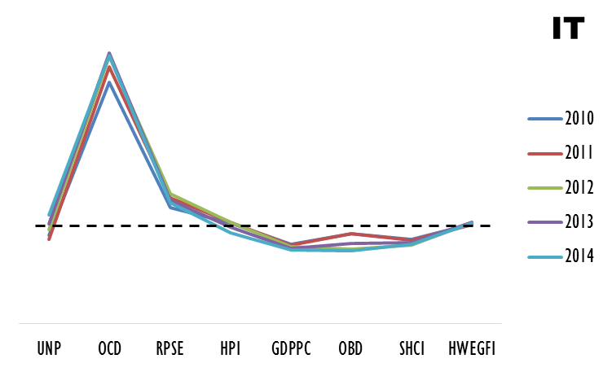
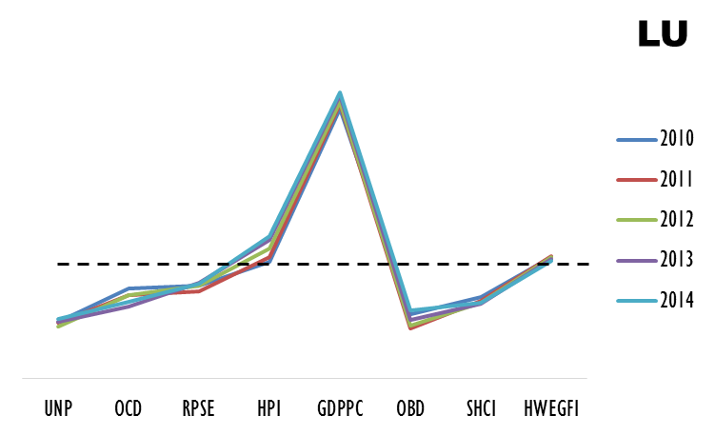
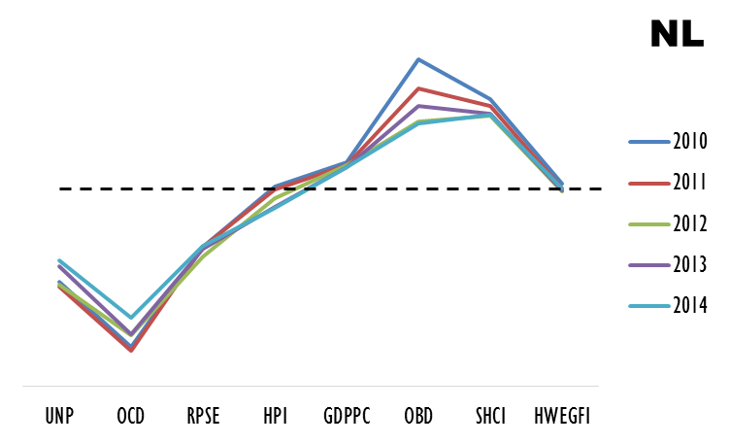
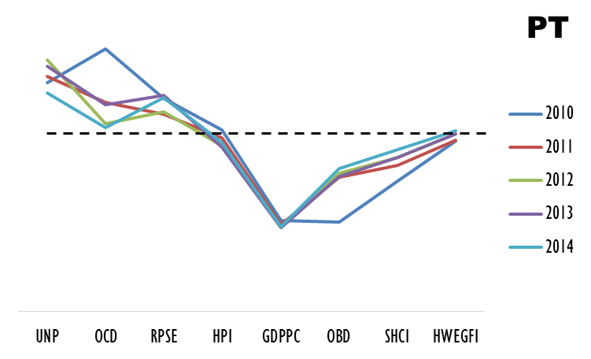
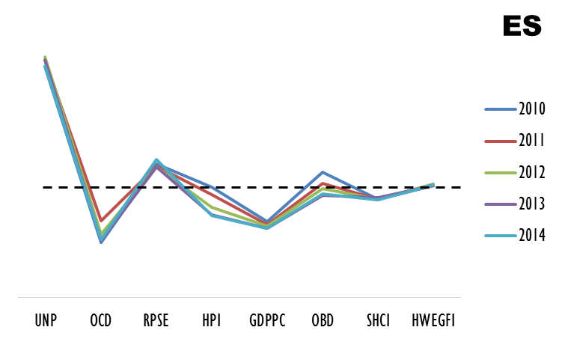
Descriptive Results
SECOND REALITY
FIRST REALITY
THIRD REALITY
OWNER-OCCUPIED DWELLINGS
 | HOUSING ACCESSIBILITY
 | OBD | SHCI | HWEGFI
AT | ↘ | ↘ | ≈
BE | ≈ | ≈ | ≈
FI | ↘ | ↘ | ≈
FR | ↘ | ↘ | ≈
DE | ↗ | ↗ | ≈
EL | ↗ | ↗ | ≈
IE | ↘ | ↘ | ≈
IT | ≈ | ≈ | ≈
LU | ↘ | ↘ | ≈
NL | ↗ | ↗ | ≈
PT | ↘ | ↘ | ≈
ES | ≈ | ≈ | ≈
 | WELL-BEING
 | UNP | OCD | RPSE | HPI | GDPPC
AT | ↘ | ↗ | ↘ | ↗ | ≈
BE | ↘ | ↘ | ≈ | ≈ | ≈
FI | ↘ | ↘ | ↘ | ≈ | ≈
FR | ↘ | ↘ | ↘ | ≈ | ≈
DE | ↘ | ↘ | ≈ | ≈ | ≈
EL | ↗ | ↗ | ↗ | ≈ | ↘
IE | ↗ | ↘ | ↗ | ≈ | ≈
IT | ≈ | ↗ | ↗ | ≈ | ↘
LU | ↘ | ↘ | ≈ | ≈ | ↗
NL | ↘ | ↘ | ↘ | ≈ | ≈
PT | ↗ | ↗ | ↗ | ≈ | ↘
ES | ↗ | ↘ | ↗ | ≈ | ↘
Housing Stock Indicators | OML | Owner with mortage or loan (%)
 | TEN | Tennant
In the Well Being it is possible to identify three different profiles, classifying only 7 of the 12 countries under analysis
In the Housing Accessibility it is possible to identify three different profiles, classifying the total of the countries under analysis
Although measure in percentage distribution of population by tenure status, these variables are indicators estimated on a basis of the average dwellings (2010-2014).
Germany and Austria are the most connected with TEN and Netherlands with OML.

Slide 12
Exploratory Results (HJ-BIPLOT)
Contributions Interpretation (Columns)
HJ-BIPLOT simultaneous factorial representation and 3 clusters of countries
Detected Trajectories (Rows)
Contributions Interpretation (Rows)
Detected Patterns (Columns)
Life Standard
Wealth Standard
Declining
Stable
Cluster 1 | Cluster 2 |  | Cluster 3
EL2012 | EL2010 | IE2014 | AT2010 | DE2012 | FR2014
EL2013 | EL2011 | IT2010 | AT2011 | DE2013 | LU2010
EL2014 | ES2010 | IT2011 | AT2012 | DE2014 | LU2011
 | ES2011 | IT2012 | AT2013 | FI2010 | LU2012
 | ES2012 | IT2013 | AT2014 | FI2011 | LU2013
 | ES2013 | IT2014 | BE2010 | FI2012 | LU2014
 | ES2014 | PT2010 | BE2011 | FI2013 | NL2010
 | IE2010 | PT2011 | BE2012 | FI2014 | NL2011
 | IE2011 | PT2012 | BE2013 | FR2010 | NL2012
 | IE2012 | PT2013 | BE2014 | FR2011 | NL2013
 | IE2013 | PT2014 | DE2010 | FR2012 | NL2014
 |  |  | DE2011 | FR2013
Axis1 (65%) | RPSE | Population at risk of poverty (%)
 | UNP | Unemployment rate - annual average (%)
 | OCD | Housing overcrowding rate
 | HPI | House prices índex
 | GDPPC | GDP per capita
 | OML | Owner with mortage or loan (%)
Axis2 (79%) | SHCI | Share of housing cost in disposable income (%)
 | OBD | Housing cost overburden rate (as % of population)
 | HWEGFI | Annual average index-housing, water, electricity, gas and other fuels
 | TEN | Tennant
Axis1 (73%) | EL (2010-2014)
 | LU (2010-2014)
 | FI (2010-2014)
 | FR (2011-2013)
 | ES (2012-2014)
 | BE (2010-2011)
 | IT (2013-2014)
 | PT (2014)
 | AT (2012)
Axis2 (74%) | DE (2010-2014)
 | IE (2010-2014)
 | PT (2010-2013)
 | ES (2010-2011)
 | AT (2013-2014)
Stable
Stable
Life Standard
Wealth Standard
Affordability
Declining
Stable
Declining
Stable
Affordability
Declining

Slide 13
4 Discussion

Slide 14
More Affordability
2.A stable performance can be detected, except for Greece in 2010 and 2011, mostly concerning LIFE STANDARD associated with MORE AFFORDABILITY. Therefore, the countries characterized by this cluster in this time period were relatively unaffected and maintained their positioning.
Stable
3.A stable performance can be perceived concerning WEALTH STANDARD, mostly for Finland and Luxembourg, associated with MORE AFFORDABILITY. On the other hand, for all the other countries, there was a decreasing performance concerning WEALTH STANDARD related to LESS AFFORDABILITY.
Life Standard
Wealth
Standard
1.Greece revealed a decreasing performance in 2012, 2013 and 2014 concerning LIFE STANDARD associated with LESS AFFORDABILITY. In this period, Greece was subjected to measures related to the BCE/IMF/EU intervention that resulted in a negative outcome in these aspects.
Declining
Less Affordability

Slide 15
5 Conclusion

Slide 16
1
The ten selected socio-economic indicators highlighted relationships between wealth, living standards and affordability in the housing problem.
2
There are two main housing problem realities in the Eurozone linked to Wealth & Living Standards and Housing Affordability.
3
The Housing Stock Indicators (OML and TEN) are not correlated because OML is associated to Wealth Standard and TEN is associated to Affordability.
4
There are three behavioural typologies of countries, although some particularities are associated with some cluster members.
5
The methodological approach, with the use of the HJ-BIPLOT method produced a richer diagnosis, for the 2010-2014 period, of the effects of political, economic and social decisions on the twelve Eurozone Countries, by identifying their similarities and dissimilarities.
This study can be seen as a contribution to the future application of multivariate data methods in housing research. Even from an exploratory perspective, it is a potential tool for producing richer information not only for academia but also for policy makers.

Slide 17
Muito Obrigado

